Slide 1
World Forum of CSDs How Monte Titoli is leveraging Innovation Marrakech, April 11 2019

Slide 2
How Monte Titoli is leveraging Innovation
Monte Titoli, thanks to data analytics, intends to “transform numbers in precious information” to improve Clients Experience
Data is the asset,
Cognitive is the goal
The best way to evolve is by adapting quickly to transformations
Big data is not about
the data. It’s about how you analyze the data
Process Excellence is more than process efficiency: it starts from Clients needs, to redesign processes and to enhance products and services offering
Robots - the goal is to augment human capability
Process Excellence is a mix of rationalization, automation, satisfaction

Slide 3
Agility & Growth Programme
Create an AGILE operating model that fosters Growth
Agility
Growth
AGILITY is the ability to change rapidly to remain competitive and create long term value
Accelerate business development and international client expansion
Reinvest savings into GROWTH initiatives that improve competitiveness
Core Pillars
Enabling Pillars
Exceptional Client Experience 2.0
Process
Excellence
(Agile & Simple)
Digital Transformation
Enabling Technology Simplification

Slide 4
Data Analytics: a long Journey …
DATA ANALYTICS JOURNEY
DATA ANALYTICS JOURNEY
1.
2.
3.
ADVANCED REPORTING
PREDICTIVE ANALYSIS
PRESCRIPTIVE ANALYSIS
Manage data analytics aimed to facilitate data comprehension to the internal Data Owner and educate internal people to figure out business trends.
Analyse data in order to monitor customers behaviours and to leverage data to generate new services/products to foresee and satisfy customers needs.
Leverage data and massive process elaboration to forecast future trends with the objective to identify strategic solutions to drive decisions.
OPERATIONAL
EXPERIENCE
CUSTOMER
EXPERIENCE
DECISION MAKING
PROCESS

Slide 5
Data Analytics: Key Themes
1.
2.
3.
ORGANIZATION
PEOPLE
TECNOLOGY
Drive through a business approach in discovering data value and operational processes, working as a single and unique team: many brains in a single head.
Foster the exploration of all the potential correlations of data, to encourage data analysis and facilitate the adoption of predictive modelling tools.
Leverage Cloud opportunity as enabler to implement a data lake architecture and to take advantage of products and services, available in the marketplace.
SINGLE
TEAM
COMPETENCE
CENTRE
ONE-STOP-SHOP

Slide 6
Data Analytics: Enterprise Data Governance
Enterprise Data Governance is the orchestration of people, processes, policies and technology to formally manage and protect structured and unstructured data assets, with the aim to guarantee a standards-based, trusted and secure guide to data.
How is data classified ?
Who is the owner ?
Is sensitive data protected ?
What data does MT have ?
What does it mean ?
How is it related ?
Who uses the data ?
To do what ?
Who can I ask for help ?
Governance
Knowledge
Collaboration
What is the origin and evolution of the data ?
Lineage
Discovery
How can I find out if any new data is available ?
How automated is this task ?
Quality
Availability
How accurate and complete is the data ?
Can I trust it ?
Where is the data ?
How can I access it ?

Slide 7
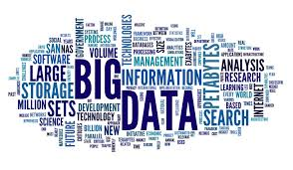
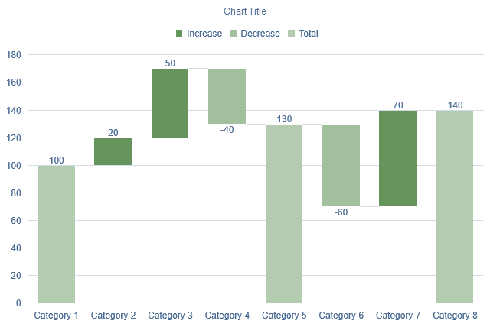
Data Analytics: Educational & Cultural Path

Slide 8
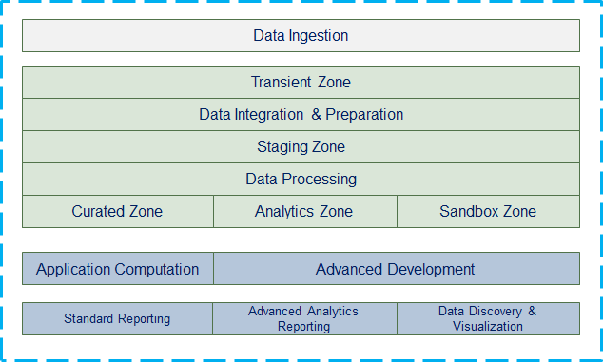
Data Analytics: Data Lake Architecture
A Data Lake allows to:
collect and store any type of data (structured, unstructured, streams), at any scale, at low cost
secure data and prevent unauthorized access
catalogue, search, and find the relevant data in the central repository
quickly augment capacity or increase environments
easily perform new types of data analysis thanks to a broad set of analytic engines for ad hoc analytics.

Slide 9
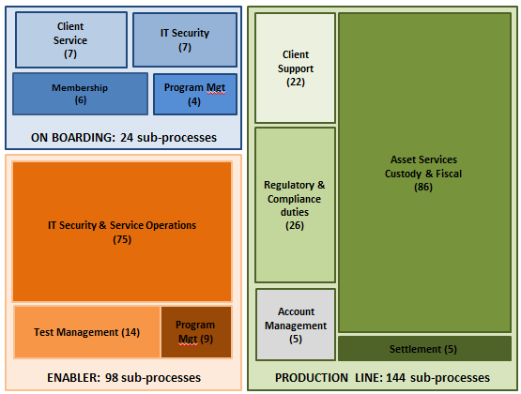
Process Excellence
To deliver Process Excellence through agility, we need to improve and re-think our core processes, thanks to the Lean Six Sigma (LSS) methodology.
Monte Titoli Business Process Mapping
On boarding: processes related to the activities that have to be done when on-boarding a client
Operations: processes related to the activities that are necessary to provide our services to clients
Enabler: all the processes related to the activities that enable the production line to work properly

Slide 10
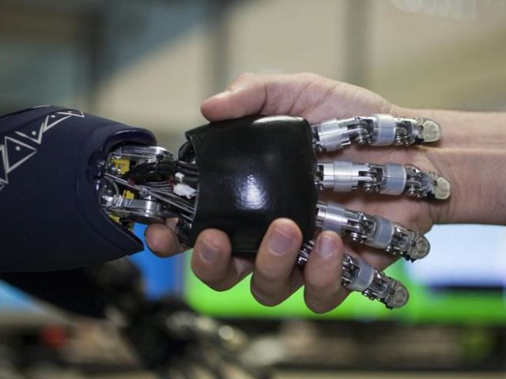
Process Excellence: Robotic Process Automation
Robotic process automation (RPA) is the practice of automating routine business practices, with "software robots" that perform tasks automatically.
We consider the use of RPA to reduce operational activities, mitigate risks, and enrich the customer experience
We employ RPAs to automate repetitive and low value activities, also in an unattended mode
With this automation we are going to reduce the human cost and save HCs
The saved HCs will be dedicated to support customers and the growth of volumes
Robot:
as «special colleagues», not competitors
work with and for us, not in place of us

Slide 11
Robotic Process Automation: Key Themes
1.
2.
3.
METRICS & BENEFITS
CHALLENGES
KEYS FOR SUCCESS
Speed - Increase productivity
Quality - Improve accuracy
Risk – Mitigate mistakes
People - Transform people effort
Efficiency – Reduce costs
Take a business perspective to reduce or simplify demand
Drive end-to-end process standardisation to avoid unnecessary automation
Ensure technology is ready to deploy robots at scale
Manage bots and human talent together
Initiate a cultural change to automation, training managers to the new role
Finding right opportunities
Evaluating and estimating the full impact
Reengineering first and reviewing operational processes
Redesigning roles and re-skilling people
Creating reusable designs to be leveraged across different solutions and business areas
VALIDATION
APPROACH

Slide 12
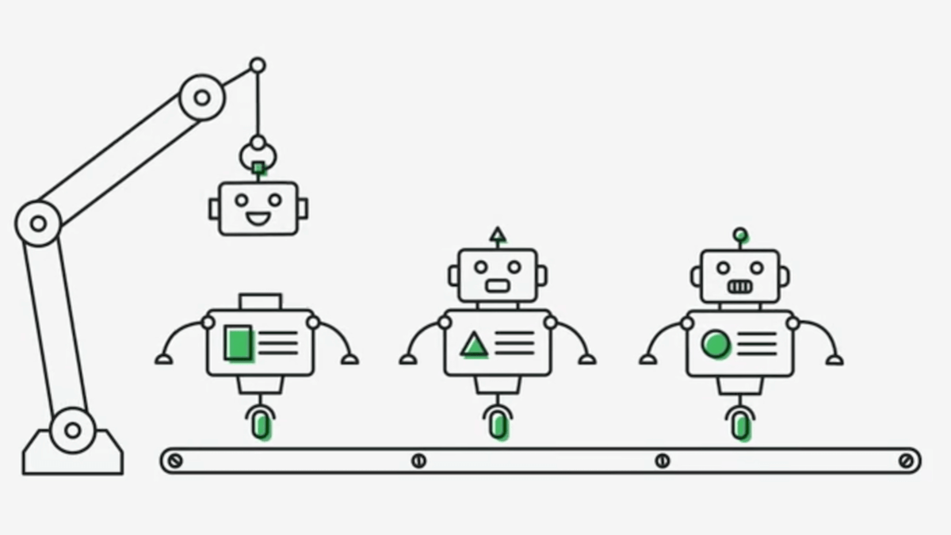
Robotic Process Automation: Validation Approach
The business process is evaluated in order to understand if the organization can reap benefits from its automation and to validate the approach, assign the correct priority to the RPA implementation.
Cost of development
Return
Of
Investment
Cost of current service
Analysts * pay per hours
Developers * pay per hours
Maintenance * number of bots
Number FTE involved
Hours per years to be saved
People from low to high-add value activities
Payback period
Risk reduction
Speeding up process

Slide 13
Robotic Process Automation: Key Initiatives
1.
2.
3.
KYC PROCESS
DIGITALIZATION
ARTIFICIAL INTELLIGENCE
Digitize KYC/on-boarding process, aimed to speed up the workflow, to automate the documentation gathering process with the aim to digitize it.
Digitize information and data coming from internal/external sources, with the aim to enhance volume of data to be used, mitigating risks as well, replacing repetitive manual tasks through robots.
Leverage artificial intelligence solutions to maximize value of the automation, thanks to the RPA’s combination with other technologies (NLP, machine learning, etc…).
ENHANCE
CLIENTS EXPERIENCE
ENHANCE
DIGITALIZATION
ENHANCE
EFFICIENCY

Slide 14
Robotic Process Automation: Use Case – As Is
Daily Market Notices are manually downloaded by Operations team
Users verify notice contents, select the relevant types of the notice and for each of them they collect the meaningful data
Users input meaningful data for the selected notices on legacy MT System
- ISIN Code
- Settlement Date
- Market Source
- ….
- Notice 1 OK
- Notice 2 KO
- Notice 3 OK
- ….

Slide 15
Robotic Process Automation: Use Case – To Be
DATA CAPTURE
+
+
MULTI-CHANNEL DOCUMENT SCRAPING
FORMAL DATA CHECK AND TRANSFORMATION
LEGACY MT SYSTEM OPERATION
DOCUMENT CLASSIFICATION
ABSTRACT
INFORMATION
WEBSITE
KNOCK-OUT
DELISTING
ISIN CODE
DATA PRESENT
LOGIN
PERIOD INTEREST
RATE
SETTLEMENT
DATE
DATE FORMAT
TRANSCODING
ROBOT DATA
INPUT
DATA
PROVIDER
BTP ADMISSION
DATE
DATA
VERIFICATION
DATA
CERTIFICATION
EMAIL
MARKET SOURCE

